Slide 1
Algoritmo paralelo cnc
Rango/ChunkSize | 1k | 10k | 25k | 50k | 100k | 250k | 500k | 10m
1-1000m | 12.78 | 6.35 | 5.80 | 5.78 | 5.31 | 5.34 | 5.52 | 5.9
1-10m | 0.07074 | 0.0647 | 0.0642 | 0.0656 | 0.0672 | 0.0770 | 0.0865 | 0.1025

Slide 2
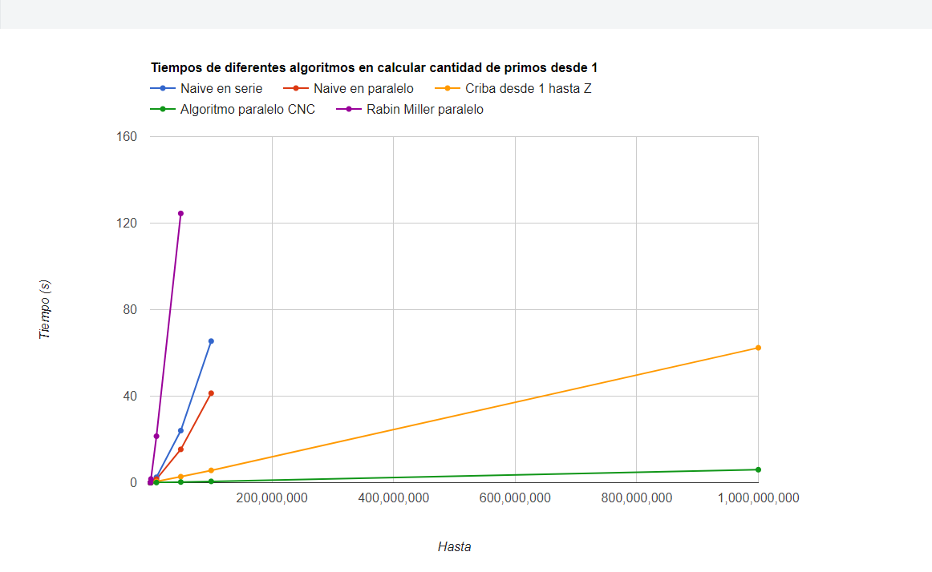

Slide 3
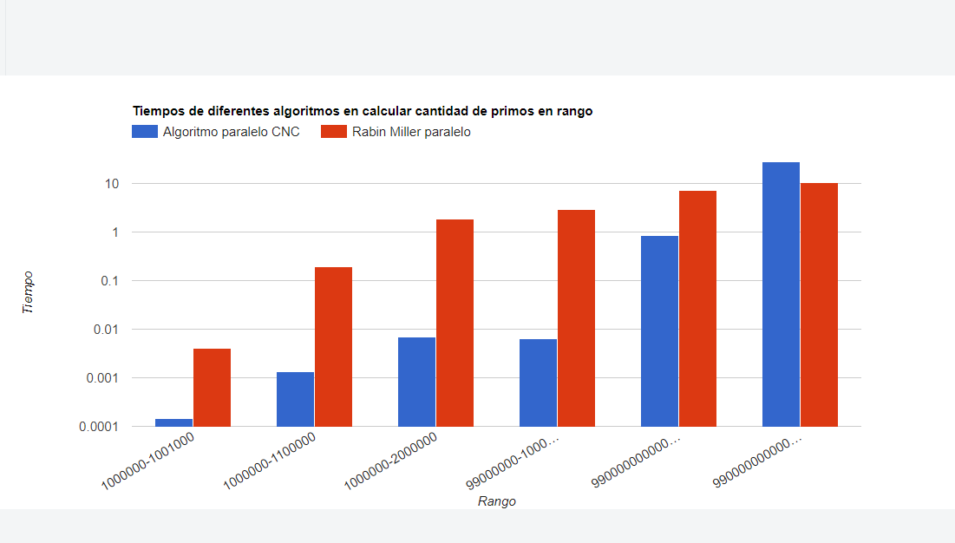

Slide 4
